Slide 1
Colegiul de Industrie Alimentara Elena Doamna, Galati, Romania, 15th -20th of September 2024

Slide 2
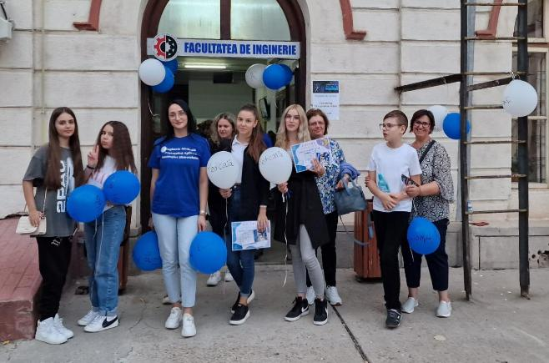
Compost trip to Food Science Faculty

Slide 3
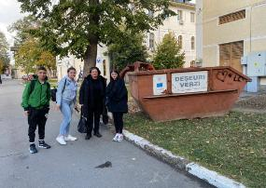
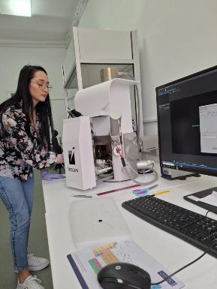
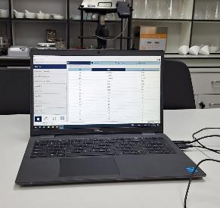
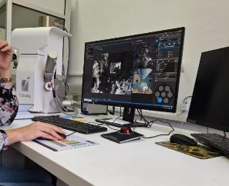

Slide 4
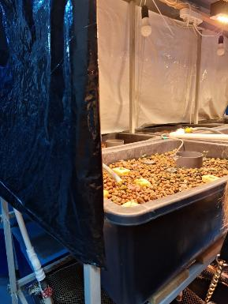
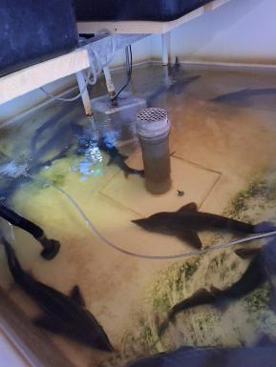
Faculty of Aquaculture and Fisheries - sturgeons

Slide 5
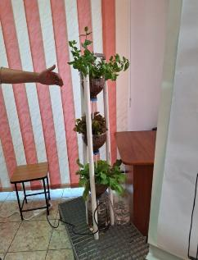
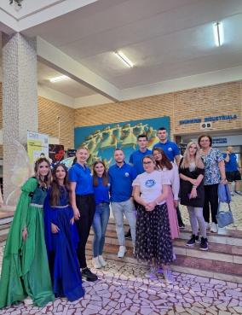
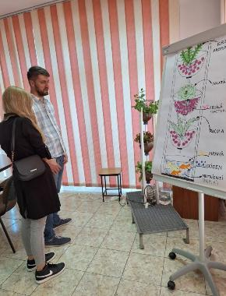
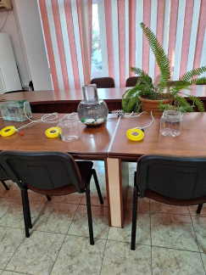
Aquaponics
Water with organic waste from fish - nutrients for various plants

Slide 6
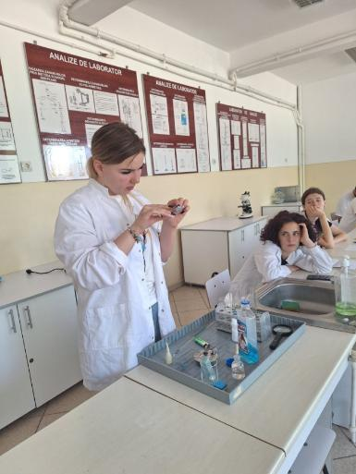
Bacteria Analysis of compost in laboratories

Slide 7
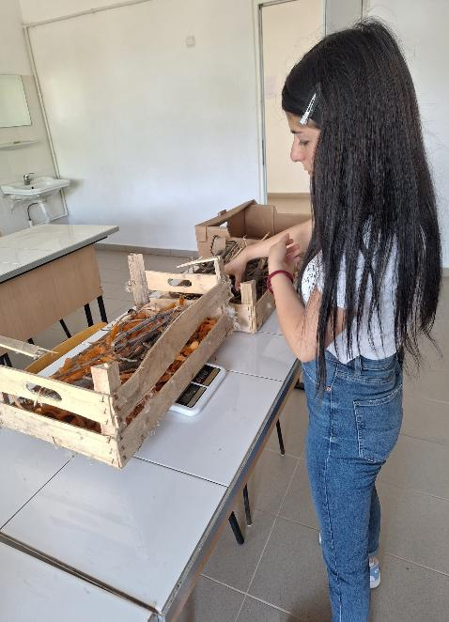
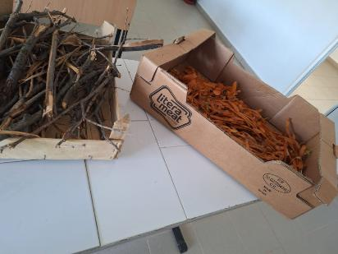

Slide 8
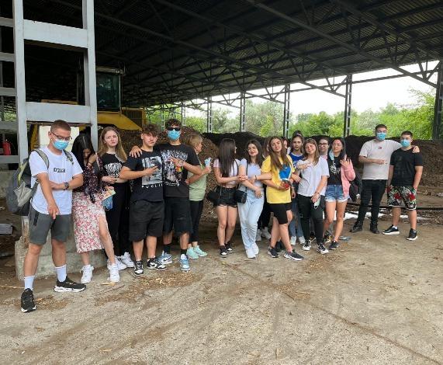
Vegetable waste sorting and composting station visit

Slide 9
Why
Landfill disposal of food waste means its anaerobic decomposition, which generates methane (CH4).
collected separately
organic waste
?
Did you know that methane is 21 times more harmful to the environment than carbon dioxide (CO2)?
composting represent application of recycling of nature.
If food waste is separated at source:
Money is saved by reducing the cost of collection
It reduces the impact on the environment by eliminating emissions due to transport

Slide 10
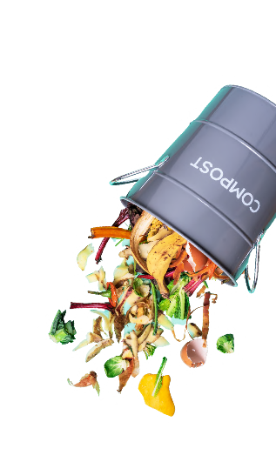
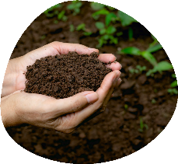
Why compost in situ?
Food waste is treated daily as it is generated
It is a hygienic process
No need to transport food waste
Compost sweep obtained with ZERO emissions
Savings by eliminating collection and shipping costs
Zero emissions
We obtain a matured compost of the best quality that can be used

Slide 11
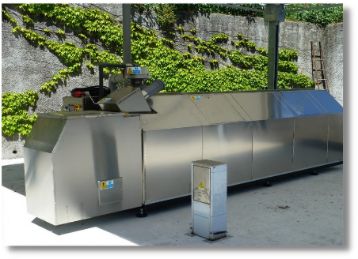
History of Big Han
The Big Hanna system was invented by the Swede Torsten Hultin and has been on the market since 1991.
The first unit was commissioned in a residential area near Gothenburg in Sweden.
By recreating the circle"grow - eat - grow", Torsten wanted to make people aware of how society uses and/or misuses its resources, as well as how dependent we are on the environment both locally and globally.
Recreation
the named circle "grow-
eat - grow"

Slide 12
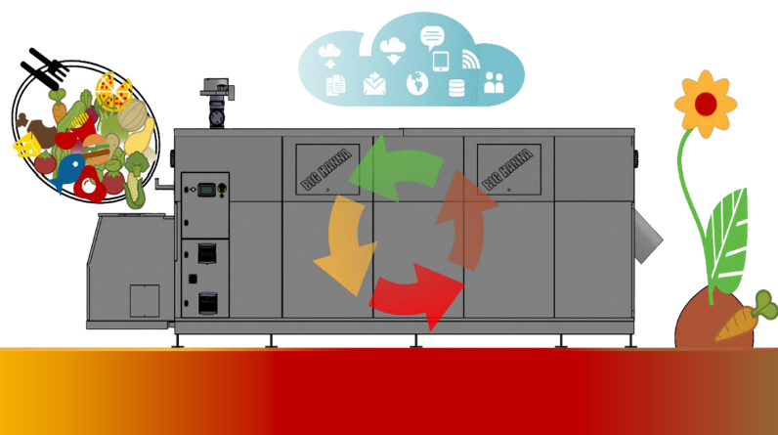
How it works
the Big H system
100 kg of waste food and pellets added generate approximate 20-30 kg of compost of quality
100 kg of waste
power supply +
absorbent material
Waste is fed into
composter together with 10-20% (by mass) absorbent material
Composting in Big Hanna
The result: 10 kg of compost + sawdust
The biological process what takes place in
the Big composter Hanna cuts back the waste
supply with up to
at 90%
100kg of waste
al imentation and pellets i add generate
about 20-30kg of quality compost,
rich in nutrients and micro elements,
environmentally friendly surrounding

Slide 13
What can be done
compost with
the Big H system
Big Hanna can compost a very wide range of waste and green waste such as:
Food waste:
raw or cooked uneaten food
leftovers from food preparation i
vegetables, fruits, bread, dairy, fish, meat, eggs Coffee (including coffee filters)
Big Hanna can compost a very range wide of debris food,
no matter if
are they cruel or
cooking
Chopped soft (light) green waste
Compostable bags marked "HOME" – Compostable at home

Slide 14
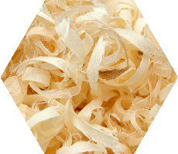
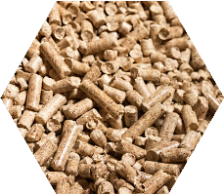
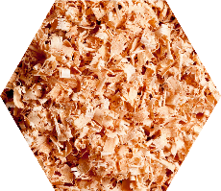
What material absorbent it is possible use?
The absorbent material can be composed of wood pellets, sawdust, shredded wood (sawdust), etc. , in a proportion of 6% to 20% of the total mass of agricultural waste introduced daily into the composter.
FUNCTIONS
Absorb the ichlid
Brings carbon into the process
Absorb excess liquid
The amount necessary d material absorbing of 6-20% d leftovers
parings

Slide 15
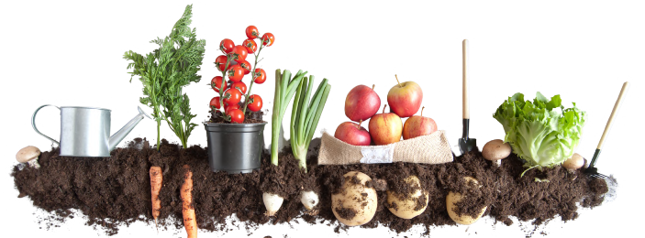
What is compost? sweep?
Matured compost can be packaged under its own brand and recycled because it can be used in a multitude of applications.
Soil amendment–improves soil quality.
Analyzes show that it is avery good quality compost.
The analysis results also show that in the compostthere are no pathogens( Salmonella or E-col i).
It can beused as flower soil, pots for seedlings, green spaces,And so on in the proportion of 1 part compost to 5 parts soil.
compost mature maybe be used as land by
flowers, in pots for
seedlings, etc.

Slide 16
Where possible compost using the Big H system
Big Hanna composts worldwide for:
MUNICIPALITIES
SCHOOLS
RESTAURANTS
Attendance at global level in restaurants, canteens, schools, prisons, etc.
CANTEEN
KITS
RESIDENTIAL
prison
HIGH EST SITES SECURITY

